Slide 1

Chassis Upgrades
Tasks
Differential Bar
Chassis Panel covers
Battery Clips
Cross members

Slide 2
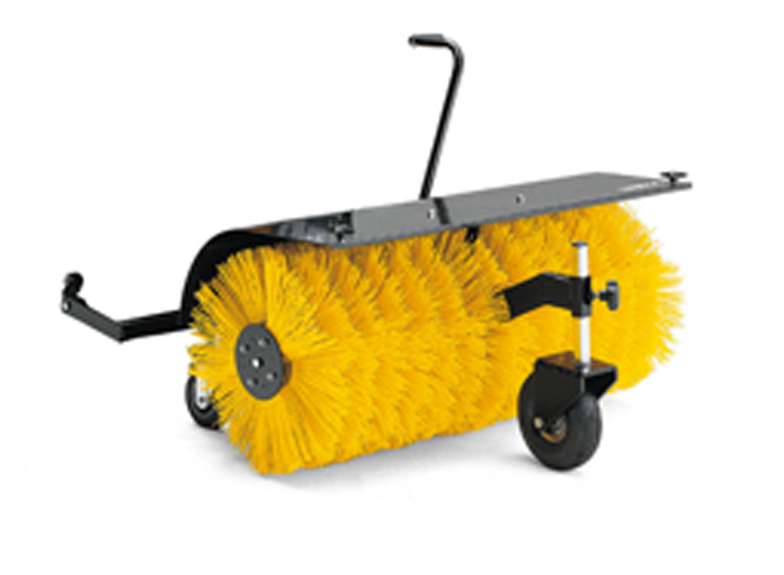
Design Idea #1
Solar Panel Cleaning Tool
Pros
Rotary brush, its super effective.
Efficient.
Fast.
Cons
Complex.
More possible failure points.
Notes:
http://www.franknicol.co.uk/product_images/c/13_0977_61__79287.jpg

Slide 3
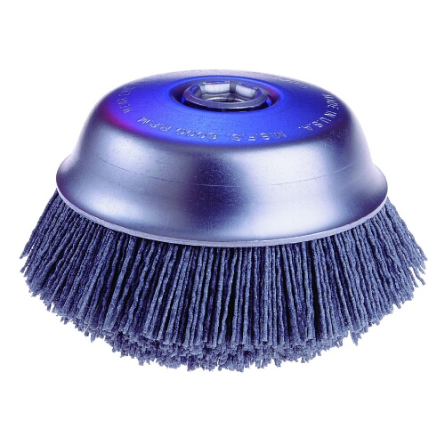
Design Idea #2
Solar Panel Cleaning Tool
Pros
Simple.
Fewer points of failure.
Cons
Lower efficiency.
Not as effective.
Notes:
http://www.erindustrial.com/images/zerimages/500/OSB-32125HR.jpg

Slide 4
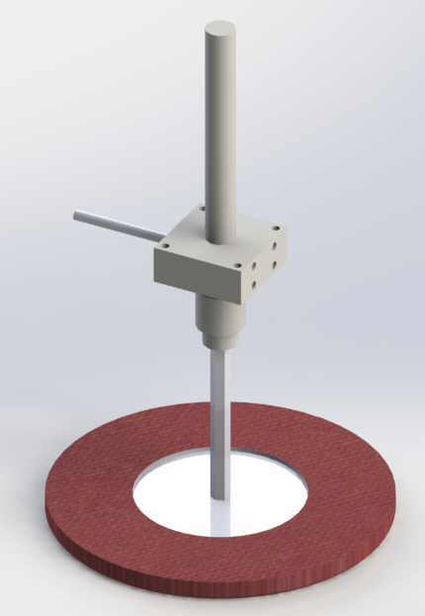
Design Idea #3
Solar Panel Cleaning Tool
Pros
Simple.
Moderate points of failure.
Previous semester design, Few changes needed.
Cheap.
Cons
Low efficiency.
Not as effective.
Notes:
http://www.erindustrial.com/images/zerimages/500/OSB-32125HR.jpg

